Slide 1
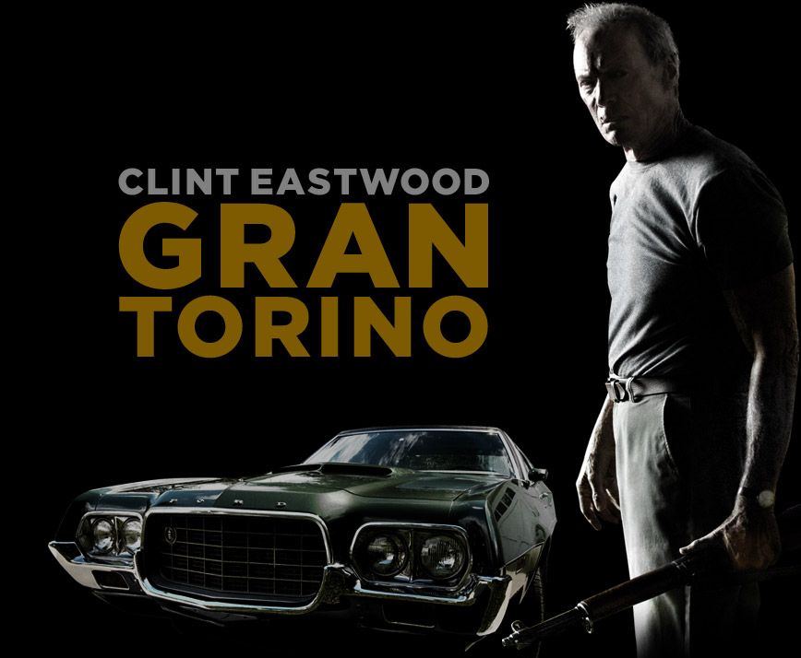
Explore the notion of identity within the context of social hierarchy in the films studied

Slide 2
Understanding the Question “Explore the notion of identity within the context of social hierarchy in the films studied.”
Identity in visual texts: Visual texts are often produced with the intention of endorsing or criticizing notions of identity. Our identity defines us as individuals from those around us and is shaped by the culture and context which impacts upon us.
Social Hierarchy: This is symbolic of the power struggle clearly evident within societies. Hierarchy is based upon social class, race, gender, beliefs, power etc.
Every individual with a particular social setting has to try to find their own identity within their society. Some will remain independent and true to their values as Walt did in Gran Torino, whereas others will disregard their traditional values as a group/society and seek refuge within a separate group; for example the gang mentality exhibited by those in Gran Torino. Alternatively, some individuals will create alliances as a means of self-preservation within a community as is evident with the prisoner in the “Shawshank Redemption”.

Slide 3
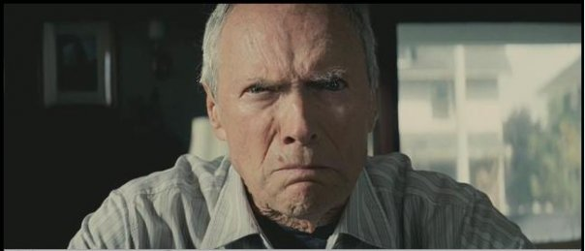
Walt Kowalski A brief summary
Walt Kowalski, created and played by Clint Eastwood
War veteran and recent widower, lives solitary in a neighbourhood which has been largely “taken over” by ethnic minorities.
The essence of Walt’s persistence in remaining in his home, is his ideology that he is a hard working American who fought for his country and will not be displaced.
He is bitter and resentful toward the H’mong family who move in next door but over time comes to accept them and eventually protect them.
Walt’s character progresses in tolerance and acceptance through a critical change in values.
Ultimately, Walt’s desire in life is to atone for his sins which date back to his time in the war so that he may be at peace with himself in his fast-approaching demise.

Slide 4
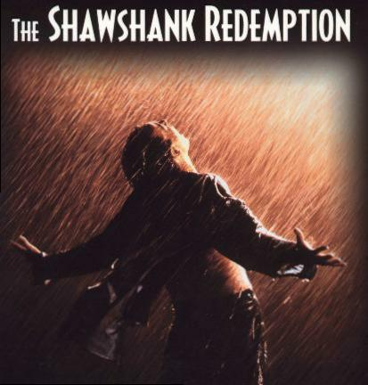
Andy Dufresne A brief summary
Andy Dufresne, played by actor Tim Robbins
Wrongly convicted of the horrendous crime of murder and sent to Shawshank prison; a place where order and chaos go hand in hand.
Playing the role of a holy figure; Jesus Christ, Andy is positioned from the start of the movie to be seen as an innocent man.
“The Shawshank Redemption” depicts social hierarchy clearly from a religious viewpoint. In addition, the film indulges in the misuse of power with a religious connection, and also presents a negative positioning toward the shackles of prison and institutionalisation.

Slide 5
Andy and Walt Connections and Ties
Mutual connection to Jesus Christ.
How they are positioned as Christ figures: - It is through the actions of these men that they gain such high accord -These actions include self-sacrifice for the greater good, the embodiment of masculinity and the protection of those who are weaker than themselves.
They are both lone figures, solely relying on themselves, holding strength through individuality.
They are both able to break free of that which binds them; for Andy this is the escape from prison, and for Walt this is his escape from his own resentment of himself.
Factors which separate the identity of these characters include age, attitude, and complexity (Walt being a more simple man than Andy).

Slide 6
The Role of Textual Conventions In defining identity through social hierarchy
Many textual conventions are employed in the films studied to express identity in the context of social hierarchy.
Suspension of Disbelief
“Gran Torino” is unlike most films
Unbiased, truthful representation of the H’mong people and the gangs in the U.S
Viewer is able to understand the contrasting cultures more clearly and is thus able to see the social hierarchy at play here.
Similarly, in “The Shawshank Redemption”, producer Niki Marvin presents the harsh reality of the judicial system of 1940’s America and prison life so as to keep the film real and allow the audience to see the film as a truly honest representation of society at the time. As a result, the viewer is shown a virtually unbiased take on the hierarchy in prison.
The film “Gran Torino” uses figurative language as a means of defining the roles of the characters in society and how they communicate.
Walt and his barber pass words of a seemingly hurtful manner between one another, though they are intended to be affectionate. This plays into the ideal of masculinity.
Lack of female roles

Slide 7
Binary Opposition
The use of binary opposition is prominent throughout both “Gran Torino” and “The Shawshank Redemption”. It is used in both films so as to emphasise the difference between setting, characters and values.
In “Gran Torino” a clear juxtaposition is made between gangs and individuality, cultural difference, age and gender.
Individuality and masculinity are privileged notions of identity.
The writers of this film identify gangs by establishing stereotypes and multiple associations from everyday life.
The film shows the identity of individualists as people who are uncertain of their chosen path and who have unique viewpoints.
Simply put, this binary represents individuality in a positive light, while gangs symbolize a bad or evil group of people. In between these two extremes of identity lies family
Walt is central and dominant in this, so as a result of his direct connection to individuality, it can be said that a strong, lone figure stands higher in the hierarchy of society than a lowly gang of thugs.
The juxtaposition between femininity and masculinity is relatively silent in both films, as the female role’s are either portrayed in the background or not portrayed at all
Masculinity is represented as being of greater power and importance in modern society.

Slide 8
Symbolism
Symbolism is significant in both films, as it helps to portray the true meaning of what is said and done.
In “Gran Torino” the most important symbol is that of the car. It has multiple meanings with relevance to Walt, Thao and Religion.
The identity of the main character Walt Kowalski is clearly embodied in his ’72 Gran Torino.
The car is a representation of his values of masculinity, hard work and American belonging.
In American society, men often express themselves through an automobile of some kind. Many claim that they have a strong emotional connection with their car as a result of working on it themselves and taking pride in it for that reason.
Walt takes pride and happiness from the car which he brought to life. It is in this love for his car that the viewer is able to see that Walt did in-fact truly care for Thao and held him in high regard.
The Gran Torino is a religious symbol. Walt lives on in his car, a sort of guardian angel over Thao, as is shown through Walt singing as Thao drives off into the distance by the ocean. In addition, this particular scene shows the Gran Torino as a symbol of the holy Terebinth Tree, as it is in a way Thao’s gateway to heaven or rather, salvation. Once again, the film “Gran Torino” presents masculinity and religion as honourable values to hold.

Slide 9
Ideologies
There are many ideologies presented in the films “Gran Torino” and “The Shawshank Redemption” which help to explore the identity of the characters within the context of social hierarchy. Of the Ideologies present, the most prevalent include existentialism, archetypal/myth criticism and Marxism.
Existentialism is mainly prominent in “Gran Torino” through the main character Walt Kowalski.
Walt goes through a loss of power in his own neighbourhood, though this is shown silently in the film.
Walt can be seen as a character affected by the ideology of existentialism, a man who is lost without a true reason for living.
In “The Shawshank Redemption”, the character of Red also faces such a problem. Having lived in the prison for such a long time, and having gained respect and importance within that restricted community, Red is unable to find worth in his life outside of prison as he is no longer useful and no longer has any power (despite the fact that the power he held in prison was an illusion created by isolation from the outside world). The reason for Red carrying on in his life is found in Andy, as a Christ figure who gives him his salvation.

Slide 10
Archetypal/Religion
In both films there is a strong connection to religion and the influence it has on people’s identities and hierarchy in society.
Particularly in “The Shawshank Redemption”, where religion is shown to be at the peak of the power struggle through the involvement of the warden with religion.
This is a misuse of power on his behalf but it still shows the influence of religion on society as he was able to gain his position of power through a suspected involvement with religion.
The film states clearly that the Warden is not by any means a voice of Christ or any religious form where he himself says in a rather evil tone “I believe in two things: discipline and the Bible. Here you'll receive both. Put your trust in the Lord; your ass belongs to me.”
Andy Dufresne is, of course, the main connection which this film holds to religion. This is due to his role as a Christ figure. The influence of such a characteristic is seen in the men around him in the prison, who Andy alters the identity of; such examples include Andy’s work with the young man who was eventually murdered by warden Norton’s doing and his influence on his close friend Red.
The fact that Andy - as a religious figure - is able to change the identity of another human, especially a convicted man, shows how significant an impact religion can have on the identity of an individual, and therefore on their hierarchy within society.

Slide 11
Masculinity
Masculinity is an ideal consistently encountered throughout “Gran Torino” and “The Shawshank Redemption”. It is represented positively in both movies, particularly “Gran Torino”.
It plays such a vital role in this film as Walt defines himself through his masculinity. This can be seen in his car, the fathering role he plays in Thao’s life and his inability to communicate with his male peers in particular.
Through Walt’s teaching of Thao to become more of a man, it becomes evident that masculinity is a means to higher social standing. This ideal of masculinity is purely presented as an aging American way of life.
Due to Thao's’ context as a young, Asian boy, he is uncertain of the expectations placed on American men.
This may be said to have privileged the Western ideal of masculinity as Thao’s is changing to fit societal norms and Walt is not; ultimately making a statement that American culture is more acceptable that that of the traditional H’mong people.
Both films exhibit a lack of female appearance or influence, in fact, in “The Shawshank Redemption” woman are not only excluded from the screen, but also represented solely as a sexual object for the men or placed in a position to be viewed negatively by the audience f.e Andy’s cheating wife.
Walt’s ’72 Gran Torino is a clear symbol of his masculinity. The film portrays this to the viewer by showing the desire of the other male figures to acquire this symbolic car
Thao’s initiation shows that gaining masculinity is a means to gaining power and thus it can be said that the film presents masculinity as being high on the social hierarchy.
There are many other traits of Walt which express his masculinity; age, power, weapons and his experience in war inclusive. Walt’s hard experiences in life shape his identity and are the reason for the high level of respect he demands from those around him.

Slide 12
Conclusion
In both “The Shawshank Redemption” and “Gran Torino” the notion of identity and the system of social hierarchy are presented primarily through the incorporation of religion. This is presented in the main characters of Walt Kowalski and Andy Dufresne as Christ figures. As a result, religion is shown to be at the pinnacle of social hierarchy and is shown to be a great influence on the identity of the characters.
Masculinity is also represented as an honourable characteristic as both films are based largely around an American way of life, with core values being from 1940-1960.
The identities of the characters are created based on the social group to which they belong, whether it is a prison community, a strong-minded individual or a certain culture. These groups construct the hierarchy within society and within the films studied.

